Slide 1
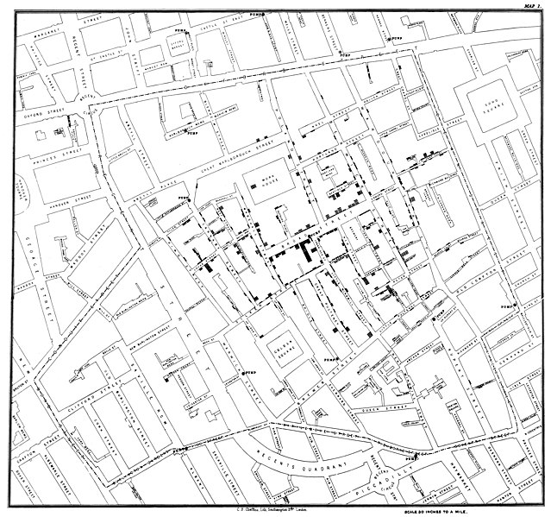
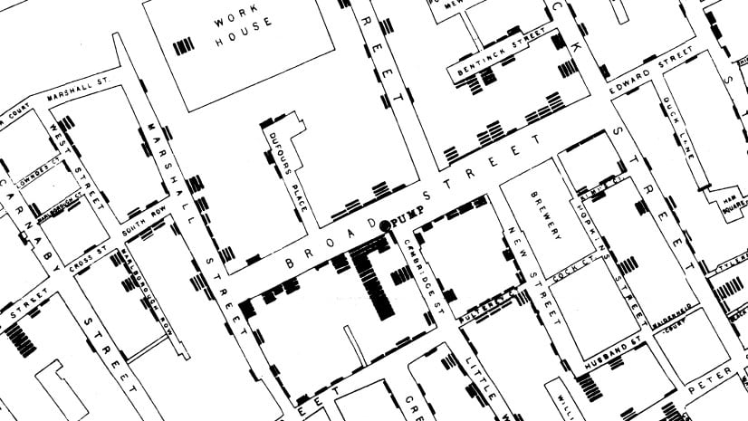
Effective Visualization II
Lab 5
John Snow ~1854
Notes:
https://www.theguardian.com/news/datablog/2013/mar/15/john-snow-cholera-map

Slide 2
Agenda
Raster & vector images, image resolution
Thinking about maps and where to get them
exporting figures from R
ggmap intro
other map sources, shapefiles

Slide 3
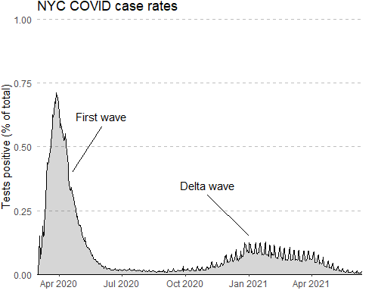
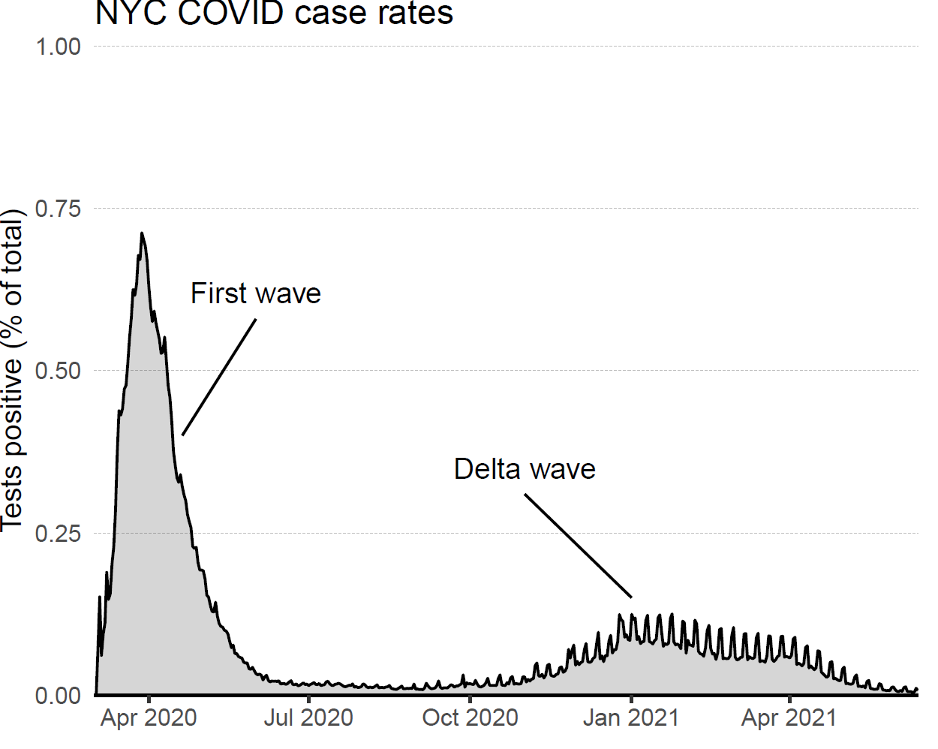

Slide 4
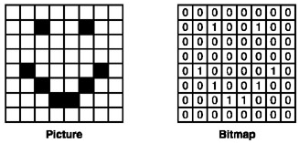
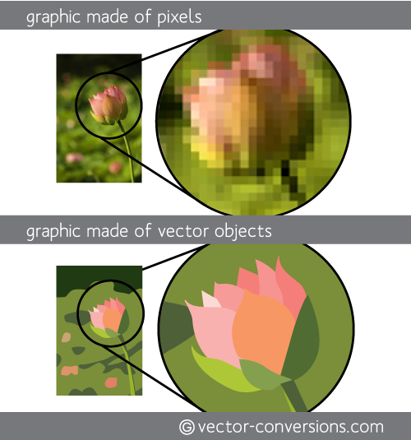
Image formats
.bmp
.png
.jpg
.tiff
Raster
.svg
.eps
.pdf
Vector

Slide 5
Image editing software
 | Platform | Price model
Raster images
Adobe Photoshop | Windows, Mac | Two limbs
GIMP | Windows, Mac | Free
Vector Images
Adobe Illustrator | Windows, Mac | Your first-born child
Affinity Designer | Windows, Mac | $70 one-time
Inkscape | Windows, Mac | Free
Figma (?) | Web-based | Free (with upgrades for $)
Canva (?) | Web-based | Free (with upgrades for $)

Slide 6
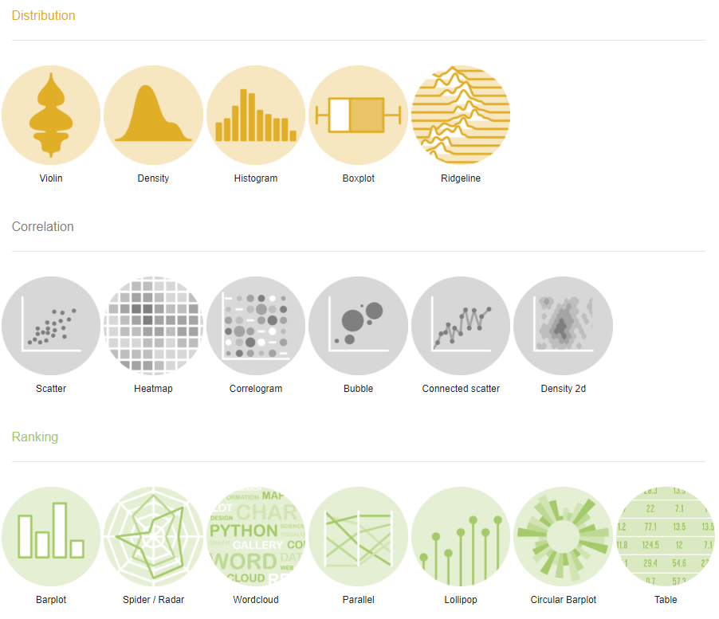
R graph gallery

Slide 7
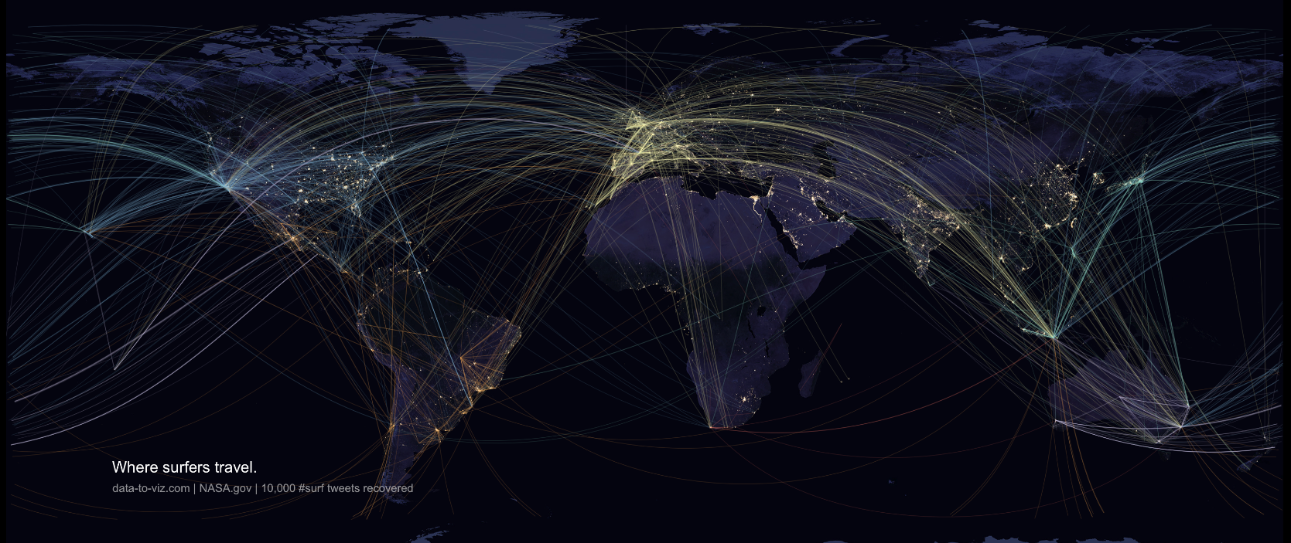
R graph gallery

Slide 8
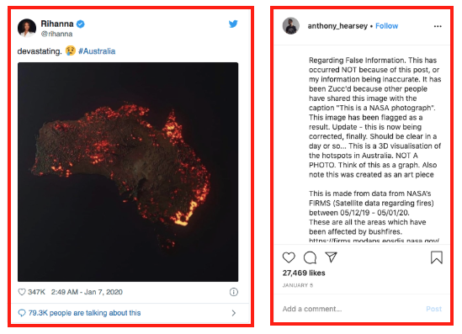
Notes:
https://firstdraftnews.org/articles/from-coronavirus-to-bushfires-misleading-maps-are-distorting-reality/

Slide 9
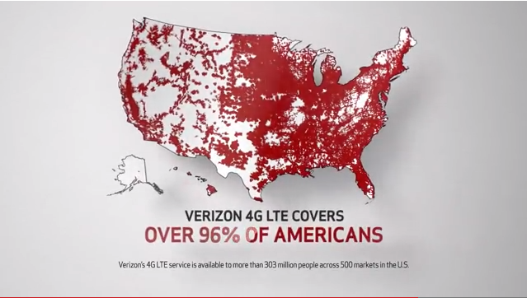
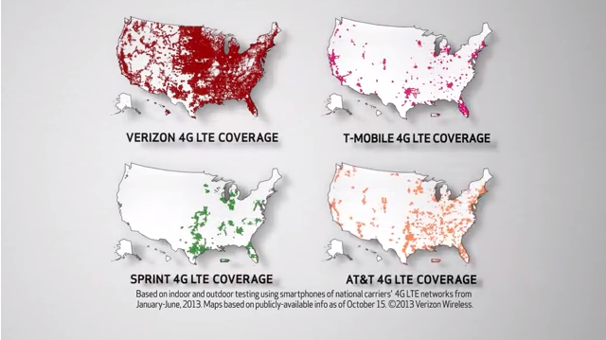
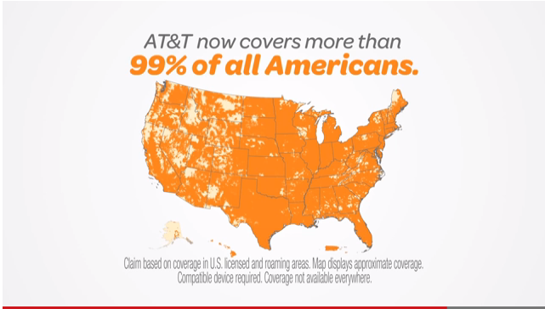
Notes:
https://firstdraftnews.org/articles/from-coronavirus-to-bushfires-misleading-maps-are-distorting-reality/

Slide 10
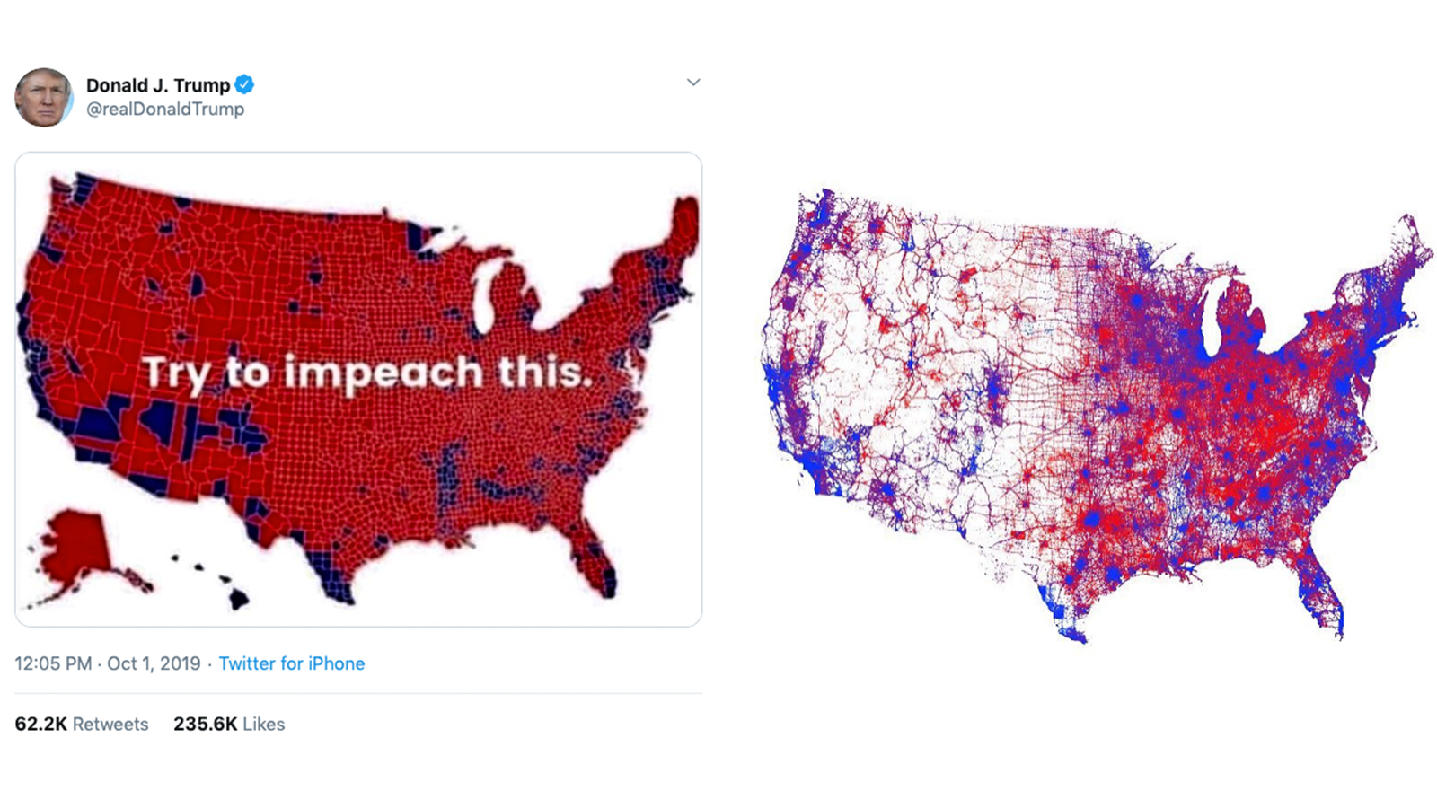
First Draft News examples of reality-distorting maps
Notes:
https://firstdraftnews.org/articles/from-coronavirus-to-bushfires-misleading-maps-are-distorting-reality/

Slide 11
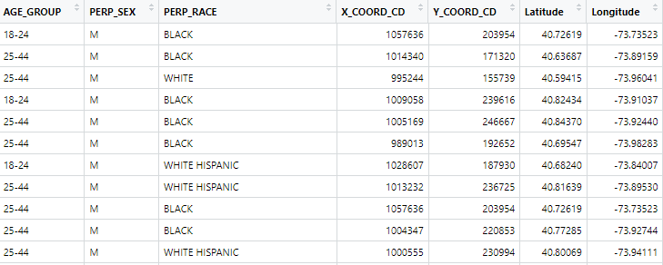
How to link this to a map?
Need:
Dataset with map coordinates (columns)
Map source (have to outsource this)

Slide 12

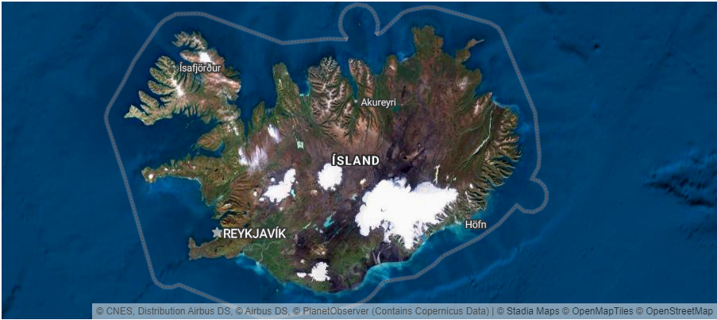
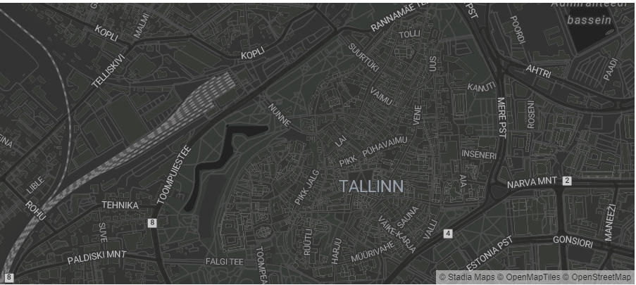
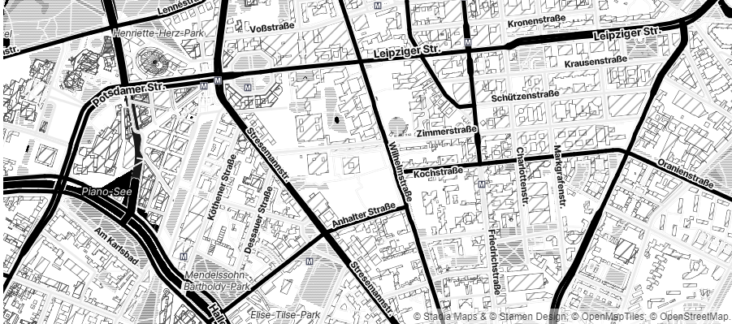
Stadia Maps

Slide 13
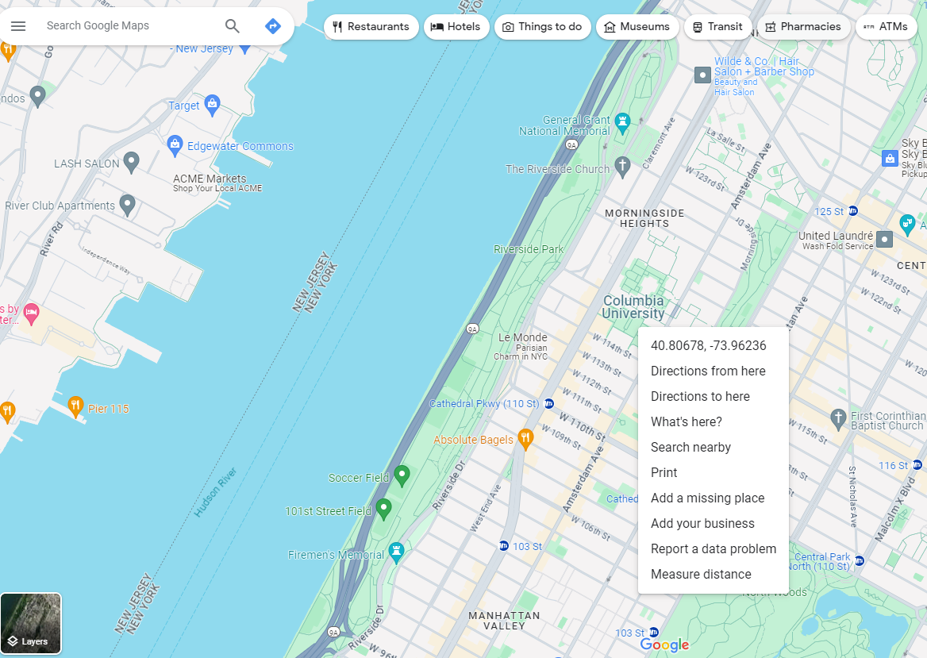
Where to find shapefiles/map data
Emory University list
RT Wilson’s blog
Google e.g.
“Tennessee shapefile”
Right-click

